Slide 1
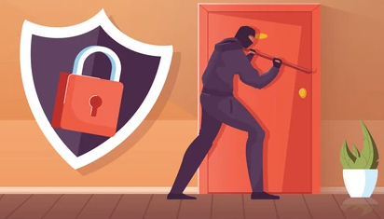
“Secure Latch: A Home Safety Initiative” IOT based Anti Theft Home Security System
By:
Abhishek Negi 076
Deepali Anthwal 084
BCA 6th M2

Slide 2

Introduction
This project integrates a password system with Ultrasonic Sensor surveillance and IoT notifications to enhance security. The password system allows authorized access, while the Ultrasonic sensor detects motion for surveillance triggering. Real-time IoT notifications alert users of unauthorized entry attempts, aiming to provide a reliable solution for safeguarding against theft.

Slide 3
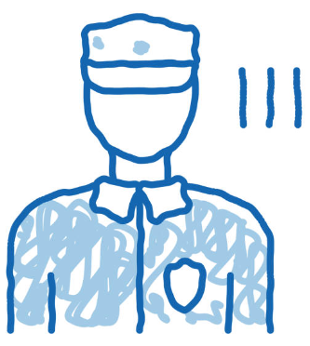
Scope
Comprehensive protection against theft and unauthorized access.
Deterrent features like smart sensors triggering surveillance.
Real-time alerts for quick responses to suspicious activities.
Customized access control with password-based authentication.
Scalability for easy integration of additional sensors.
Reliable and efficient operation with thorough testing.
Cost-effective solution without the need for expensive infrastructure.

Slide 4
Diagrammatic presentation
Enter Password
Yes
Is Password correct?
No
Person can enter the door
Ultrasonic sensor reading recorded
Iot Cloud Processes
Notification sent to Owner
(E-Mail)

Slide 5
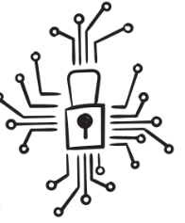
Requirements
Hardware
Software
2GB RAM
VGA Monitor
Wifi connection
USB
LED indicators
Intel 1.4 Ghz or Higher Processor
Keyboard
Mouse
Sensors – Ultrasonic Sensor
NODE MCU esp8266
Development board
Connecting wires (Jumper wires)
Keypad for Password Entering
Additional technologies as needed during the project's development phase.
Operating System (Windows 8 or 10)
Web Browser (Google Chrome, Microsoft Edge, Fire Fox, etc.)
Arduino IDE for programming
Blynk for App development and monitoring
Additional technologies as needed during the project's development phase.

Slide 6
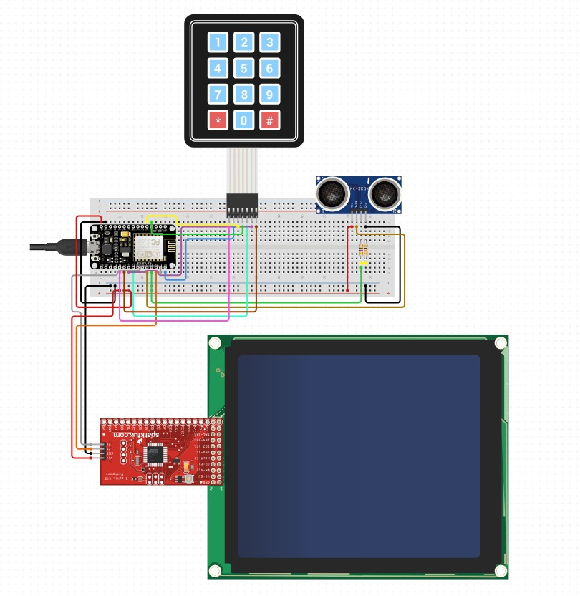
Circuit Diagram of Proposed System
Keypad (For Entering PIN)
Ultrasonic Sensor
ESP8266 NODE MCU
(Micro Controller)
Development Board
OLED Screen
I2C Extender

Slide 7
Modules Included:
Blynk IoT Connection Module:
The Blynk IoT Connection Module serves as a bridge between IoT devices and the Blynk platform, facilitating seamless communication and integration. This module enabled to connect the hardware project to the Blynk cloud infrastructure, allowing for real-time data exchange, remote monitoring, and control.
Password Module:
A password module using a 4x4 keypad provides a convenient and secure method for user authentication and access control. By interfacing the keypad with a microcontroller like NodeMCU, users can input passwords through a series of key presses. The microcontroller compares the entered password with a predefined one stored in its memory.

Slide 8
Modules Included:
Ultrasonic Sensor Module
The Ultrasonic sensor module is a component commonly used in object detection systems.
An ultrasonic sensor emits high-frequency sound waves and measures the time it takes for the waves to bounce back after hitting an object. By calculating the time difference, the sensor determines the distance to the object without physical contact, making it ideal for proximity sensing.
Notification Alert Module (E-mail Alert):
An email notification, detailing the potential security breach, is sent to the homeowner’s registered email address.
It is triggered when the user enters Wrong Password on the Keypad.
E-mail is sent Through Blynk IoT.

Slide 9
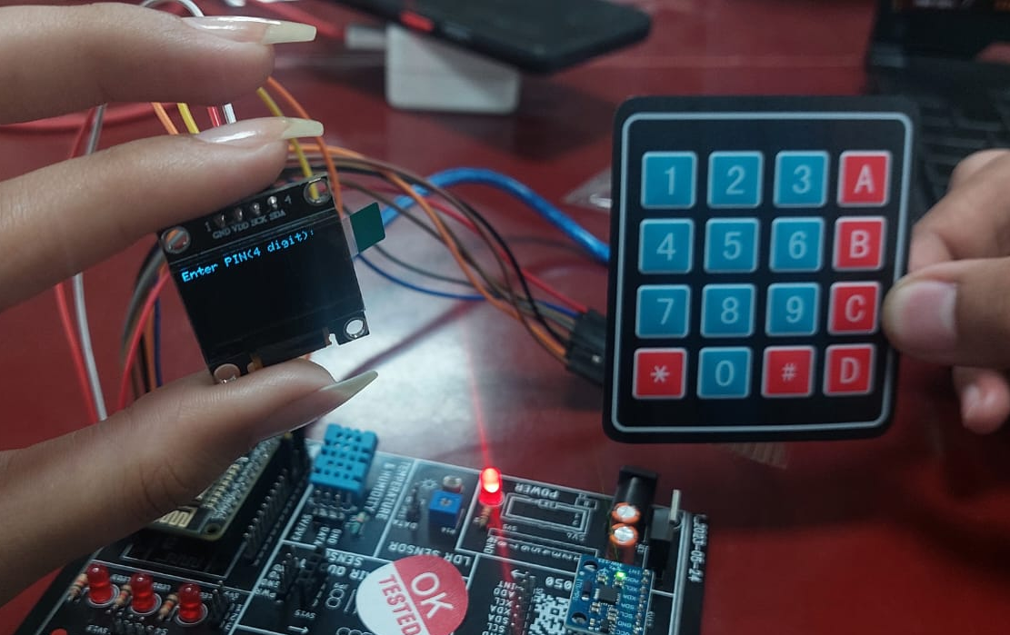
Implemented System:
Keypad Takes Input
OLED
Displays
“Enter PIN(4 Digits)”
IoT Development Board (Consists of all the connections and the Microcontroller)

Slide 10
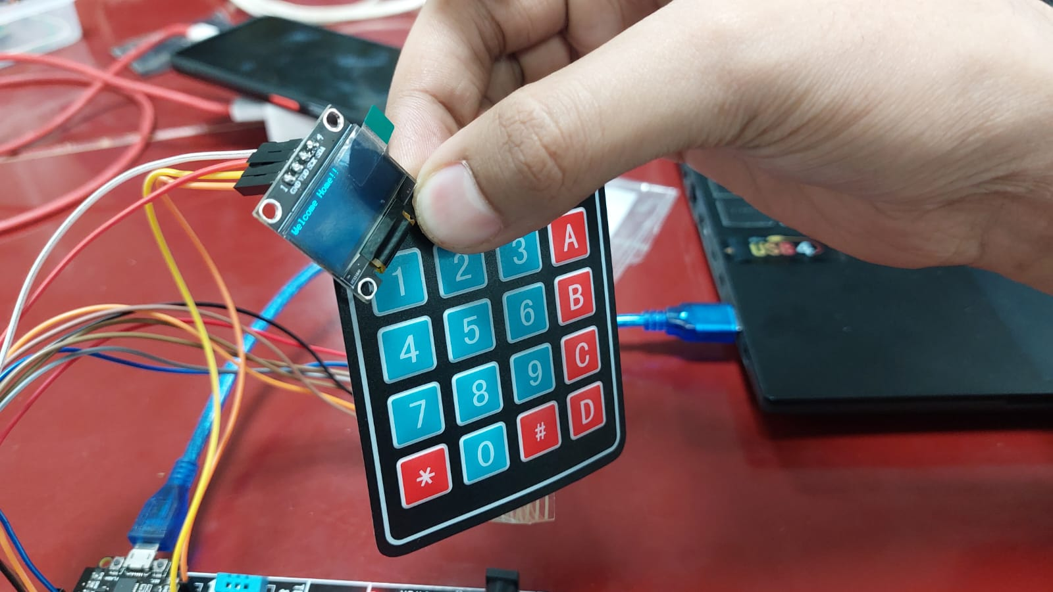
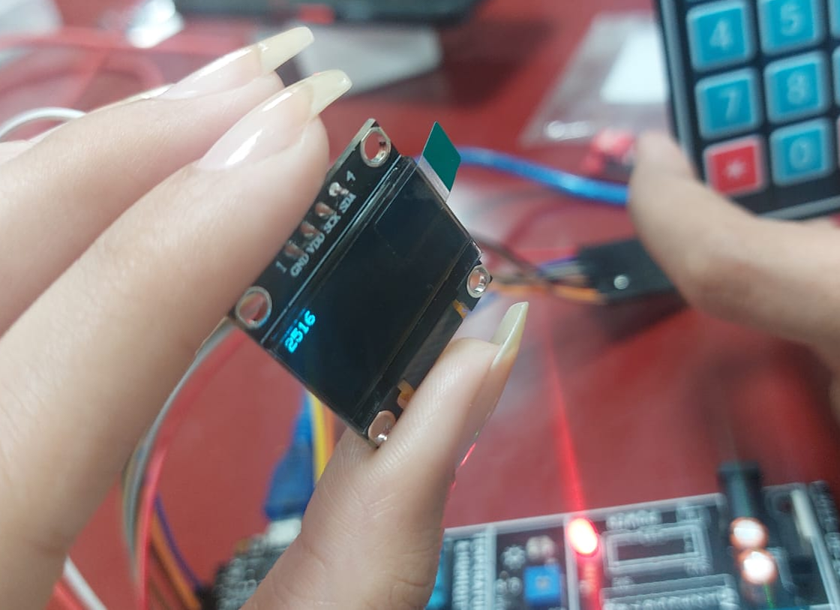
Implemented System:
OLED displayed “Welcome Home!!” as pass code entered was correct!
User Entered “2516”

Slide 11
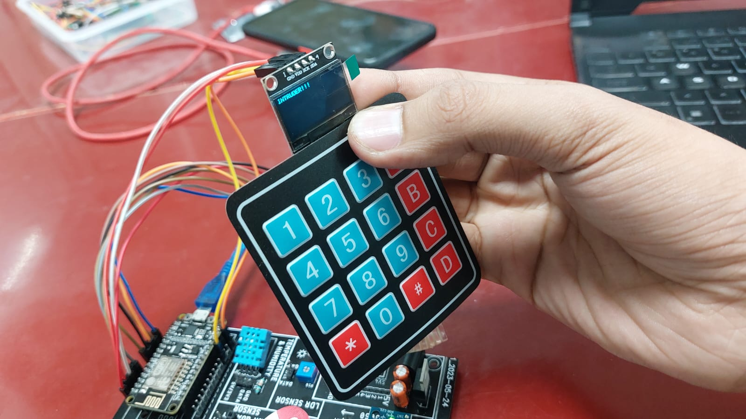
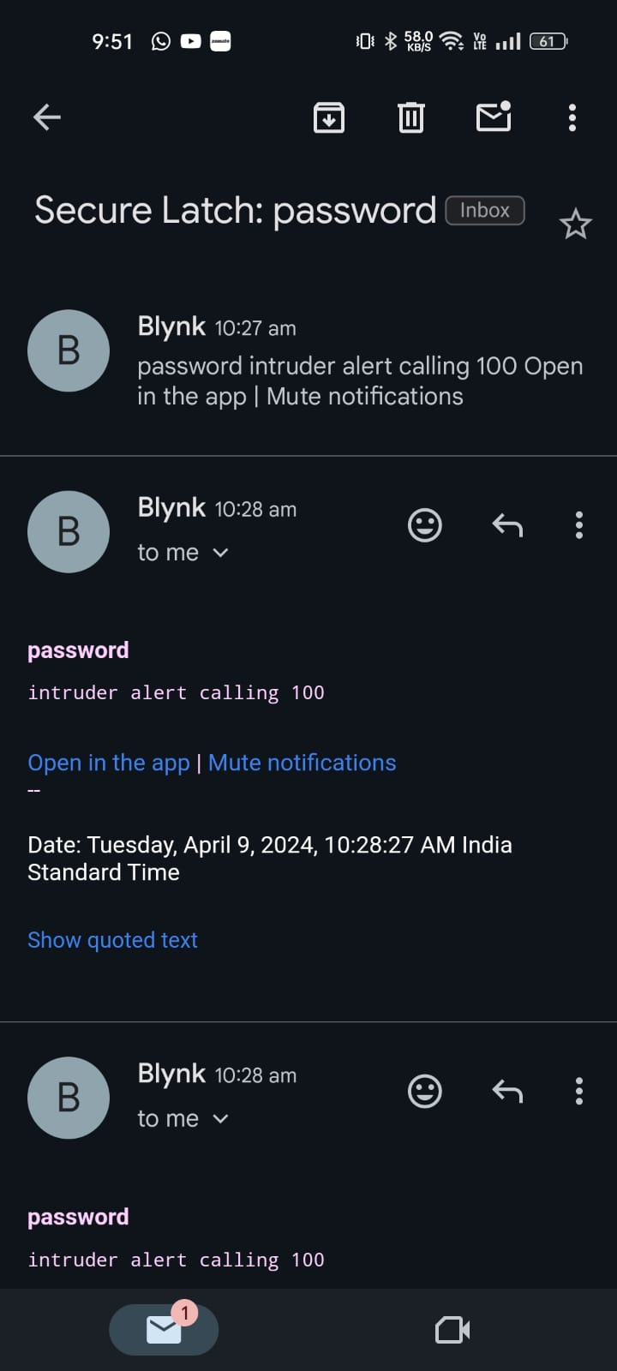
Implemented System:
OLED displayed “INTRUDER!!” as the user entered wrong pass code!
Blynk IoT immediately sent E-mail Alert to Home owner as wrong pass code was entered!

Slide 12
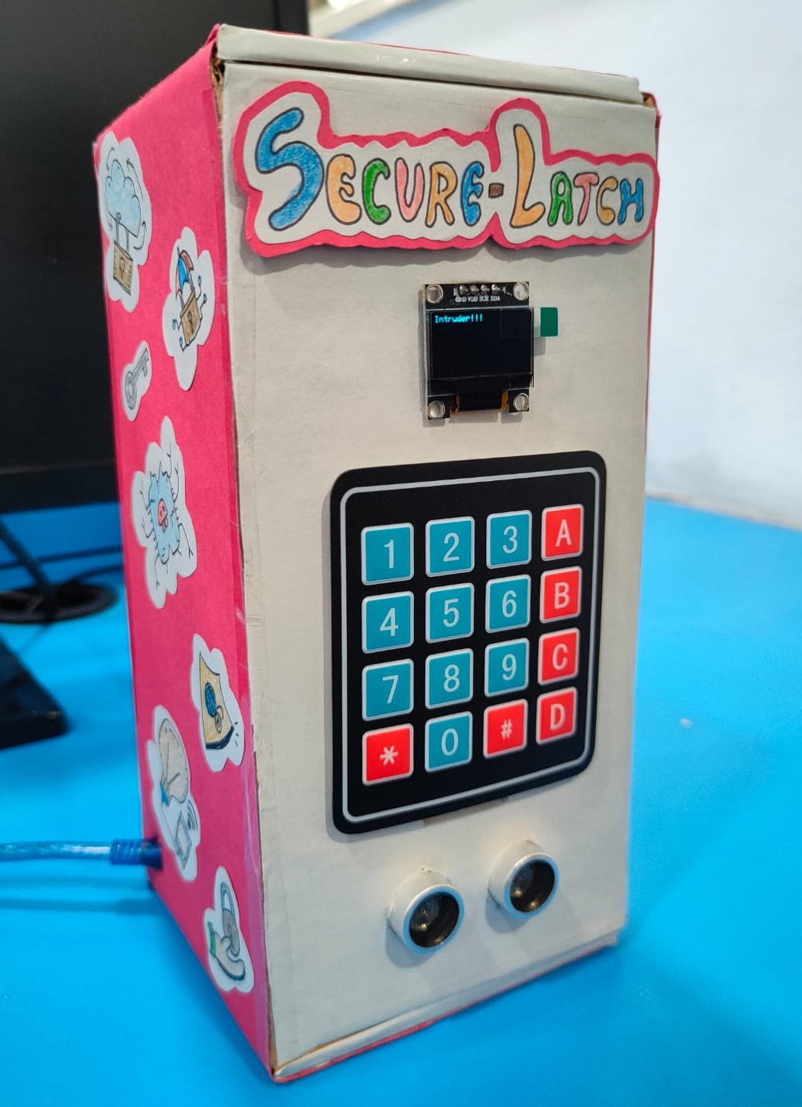
Implemented System:
OLED for Display
Keypad for PIN entering
Ultrasonic Senor for sensing objects(User) and triggering the system
Final Look

Slide 13



How this Project helps the Society?
This project provides a solution to the societal problem of home security in the following ways:
Theft Prevention: Deters intruders and reduces theft risk, boosting home security.
Instant Alerts: Real-time notifications enable quick responses to unauthorized access attempts.

Slide 14


Peace of Mind: Offers homeowners reassurance with continuous monitoring even when away.
Customized Access: Password system grants controlled access to trusted individuals, balancing convenience and security.
Enhanced Surveillance: Ultrasonic sensors detect motion for targeted surveillance, increasing security.
Affordable Solution: Provides cost-effective security, making it accessible to more homeowners.

Slide 15
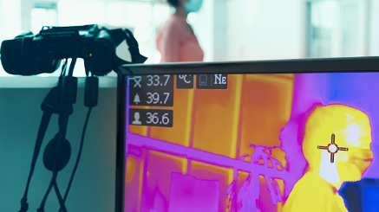
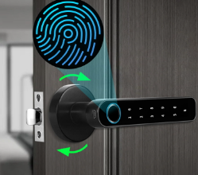
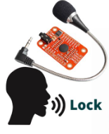
Future Improvisations!
Advanced Intrusion Detection:
Pet Immunity
Thermal Imaging
Smarter Response Systems:
Smart Lock Integration
Scene Automation
Enhanced User Experience:
Voice Control
More Security and Privacy:
Two-Factor Authentication

Slide 16
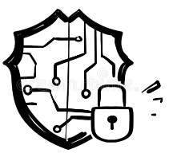
Conclusion
In conclusion, “Secure Latch” successfully developed a cost-effective and user-friendly anti-theft home security system leveraging IoT technology.
The system offered real-time intrusion detection, remote control functionalities, and timely notification through email alerts.
By incorporating future enhancements like pet immunity, smart lock integration, and two-factor authentication, this system can evolve into an even more robust and comprehensive security solution, providing homeowners with peace of mind and a safer living environment.

Slide 17



“Let's give safety a hand”

